Slide 1
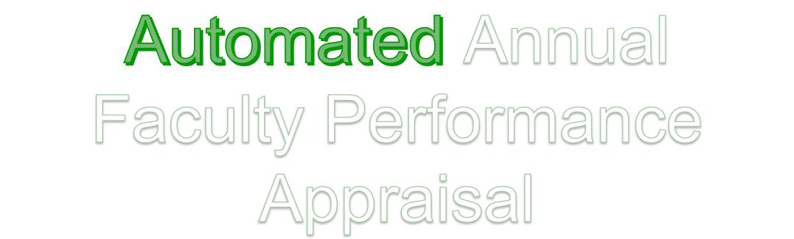
By:
Anas Hafaiz(1604-17-737-108)
Basheer Riyaz(1604-17-737-115)
Habeebuddin Mir(1604-17-737-116)

Slide 2
Introduction
The purpose of Annual Faculty Performance Appraisal is to provide a process for evaluating each faculty member based on his/her individual combination of professional activities.

Slide 3
The comprehensive appraisal system consists of the following components:
i. Evaluation by the Head of the institution
ii. Evaluation by the Head of the Department
iii. Self Appraisal

Slide 4
Existing System
Currently, the entire process of preparing and submitting of documents is done manually and is very tiresome.
It consumes alot of time and energy of alot of people involved.

Slide 5
Proposed System
This project aims to automate the entire process, where appropriate people can upload documents, get them evaluated by the heads and submitted to the respective authorities.

Slide 6
Software Development Tools
HTML5
CSS3
Java Script 1.8.5
Mongo Database 4.2

Slide 7
Modules
Admin Login(Evaluation Team)
  Verification
  Recommendtion
  New User Authentication
User Login/Registration(Faculty & Heads)
  Submission of Documents

Slide 8
System Requirements
Operating System:
Windows 7, Windows 8 or Windows 10
Mac OSX 10.8, 10.9, 10.10 or 10.11
Hardware:
Processor (CPU) with 2 gigahertz (GHz) frequency or above
A minimum of 2 GB of RAM
Monitor Resolution 1024 X 768 or higher
A minimum of 20 GB of available space on the hard disk
Internet Connection Broadband (high-speed) Internet connection with a speed of 4 Mbps or higher
Browsers:
Chrome* 36+
Edge* 20+
Mozilla Firefox 31+
Internet Explorer 11+ (Windows only)
Safari 6+ (MacOS only)

Slide 9
Conclusion
Effective implementation of this web app will take care of the basic requirements of the faculty appraisal system because it is capable of providing easy and effective submission and evaluation of documents related to activities happening in the stipulated area. With these, the objectives of the system design will be achieved.
In order to allow for future expansion, the system has been designed in such a way that will allow possible modification as it may deem necessary by the management, whenever the idea arises.

